Slide 1

COLLEGE OF ENGINEERING ADOOR
MANAKALA, ADOOR
DEPARTMENT OF COMPUTER SCIENCE & ENGINEERING
PROJECT ON
INTERNSHIP APPLICATION MANAGEMENT SYSTEM
GROUP 14
GUIDED BY
HONEY
ASSISTANT PROFESSOR
COMPUTER SCIENCE DEPARTMENT
COLLEGE OF ENGINEERING ADOOR
SRUTHY K S (ADR23CS108)
VARADA REMESH (ADR23CS109)
VISHNU MANOJ (ADR23CS110)
VARUN KRISHNAN (ADR23CS111)

Slide 2
CONTENTS
1. INTRODUCTION
2. MOTIVATION
3. LITERATURE SURVEY OVERVIEW
4. EXISTING SYSTEM
5. PROBLEMS IDENTIFIED
6. OBJECTIVES
7. REQUIREMENT ANALYSIS
8. MODULAR SPECIFICATION
9. FLOW CHART
10. FURTHER ENHANCEMENT
11. SCOPE

Slide 3
INTRODUCTION
The Internship Application Management System is a web-based application designed to simplify and automate internship applications and management. Currently, many institutions handle this manually with paper or email, leading to errors and wasted time. This system provides a centralized platform for students to apply, organizations to review, and administrators to track the process efficiently. By digitizing management, it improves accuracy, transparency, and communication, aiming to reduce paperwork, save time, and offer an organized, secure method for handling applications.

Slide 4
MOTIVATION
Transition from manual to digital
Enhancing candidate experience
Efficiency and Time-to-Hire
Skill development
Bridging academia and industry
Improved communication

Slide 5
LITERATURE SURVEY OVERVIEW

Slide 6
SLNo | Title of the paper | Technologies Used | Observations | Limitation
1 | Abdullah et al. (2017), “Web-Based Application of the Internship Management System”, Journal of Computing Research and Innovation (UiTM Malaysia) | Web-based system (exact stack not emphasized in abstract) | Replaces manual internship process; matches industry requirements with student qualifications; evaluated via heuristic + user acceptance testing | Technology stack and deployment aspects are not clearly detailed; paper focuses more on usability/testing than advanced features like analytics/notifications
2 | Mydyti & Ware (2020), “Using Internship Management System to Improve the Relationship between Internship Seekers, Employers and Educational Institutions” | Discusses web technologies/framework trends (conceptual focus) | Highlights need for a centralized IMS to connect students–business–academia (“S-B-A” linkage) and reduce time/effort | More conceptual/research-oriented; not a full implementation blueprint with modules/screens/DB schema
3 | Kapoh et al. (2024), “Digitalization of the Internship Management System…” International Journal of Computer Applications | Internship system digitalization (paper-level implementation details) | Focuses on digitizing internship workflows to improve administrative efficiency and tracking | Limited emphasis on modern product needs (integrations, dashboards, automation) in the surfaced sections
4. | Chaurasia et al. (2023), “Student Internship Placement Management System (SIPMS)”, IJRISE | Python, Django, MySQL | One-time registration; automates data insertion; eligibility checks; supports placement department workflow | Notes challenges around security and user-friendliness; scope is mostly placement-department oriented rather than personal application tracking for each student

Slide 7
SLNo | Title of the paper | Technologies Used | Observations | Limitation
5 | “Internship Management System Using MERN-Stack”, STM Journals | MERN (MongoDB, Express, React, Node.js) | Centralized internship platform; student/admin login; resume builder; location-based filtering | Article-style overview; limited technical depth on security model, evaluation, and deployment constraints
6 | “Placement Web based Application”, JETIR (2019) | Web portal approach (paper-level) | Includes notifications for recruitment rounds and matching companies with candidates (useful feature direction) | Paper scope is recruitment/placement; does not cover a complete internship application lifecycle (notes, reminders, multi-platform aggregation)
7 | “Web Based Placement Management System”, IJARSCT (example: Dhanalakshmi College of Engineering) | Web portal approach (stack not the main focus in abstract) | Shows how a centralized portal reduces manual work, improves retrieval of student placement data, and supports authenticated access | Primarily placement-centric (college office workflow); not tailored to a student’s personal multi-company internship application tracking
8 | GitHub (Open-source): “Internship Tracker” repository | Java + JavaScript (repo states “full-stack”) | Directly matches your project concept: track applications, statuses, notes, workflow management | As a public repo, documentation/testing depth varies

Slide 8
EXISTING SYSTEM
The existing system for internship application usually includes:
Students applying through emails,college placement cells,websites,or job portals.
Tracking applications using notes,spreadsheets,or memory.
No centralized platform to view all applications.
Manual communication between students and coordinators.

Slide 9
PROBLEMS IDENTIFIED
Lack of centralized platform
Poor Application Tracking
Missed Deadlines
Manual and Time-Consuming process
Data inconsistency and loss
Lack of communication
Limited accessibility

Slide 10
OBJECTIVES
Centralized Application Management: Implement a unified platform where students can apply for and track multiple internship opportunities in one place.
Application status tracking: Enable users to monitor application progress such as pending,applied,interviewing,accepted,and rejected.
User-Friendly Interface: Design an intuitive and responsive interface accessible on mobile,tablet,and desktop devices.
Efficient Data Organization: Maintain structured records of students,internship,and application history of easy access and analysis.
Secure Data handling: Ensure secure storage of user data,application details,and documents.

Slide 11
REQUIREMENT ANALYSIS
Functional Requirements:
User Management: Registration and login for students and recruiters.
Internship Management: Viewing editing and deleting internship details.
Application Management: Students can apply for available internships and track application status
Admin Management: Manage users ,monitor system activities and generate reports.

Slide 12
REQUIREMENT ANALYSIS(cntd..)
Non-Functional Requirements:
Performance: Fast loading pages and efficient handling of multiple users simultaneously.
Security: Secure login and protection of user data.
Usability: Simple and easy navigation for students.
Maintainability: Easy to update,modify and extend system features.

Slide 13
MODULE SPECIFICATION
Admin:
The admin module is designed to allow administrators to manage the overall functioning of the internship application management system.The admin is responsible for verifying internships,managing users,and monitoring system activities.
User:
The student module is designed to facilitate interaction between students and the internship platform.it enable students to explore opportunities,view verified internships,add external internship links,and update application statuses.
Internship:
The Internship module manages the storage and organization of all data about internship. It maintains structured records of internship details.

Slide 14
ADMIN MODULE
Application Management:
Used to manage all applications submitted in the system
Allows the admin to view application details clearly
Applications can be approved or rejected after verification
Application status can be updated (Pending / Approved / Rejected)
2. User Management:
Used to manage users who access the system
Displays the list of all registered users
New users can be added to the system
Existing users can be deleted if not required
User details can be modified when needed

Slide 15
ADMIN MODULE (contd.)
3. Internship Management
Manages all internship-related activities
Stores internship details such as role and duration
Tracks students applying for internships
Helps in monitoring internship progress
4. Report & Monitoring:
Used to track overall system activities
Allows viewing detailed reports
Monitors application status in real time
Generates summary reports for analysis

Slide 16
ADMIN MODULE (contd.)
5. Login:
Prompt the admin to enter their username and password.
Verify the entered credentials against the system database.
If the credentials are valid, grant access to the admin and allow them to use the system functionalities.

Slide 17
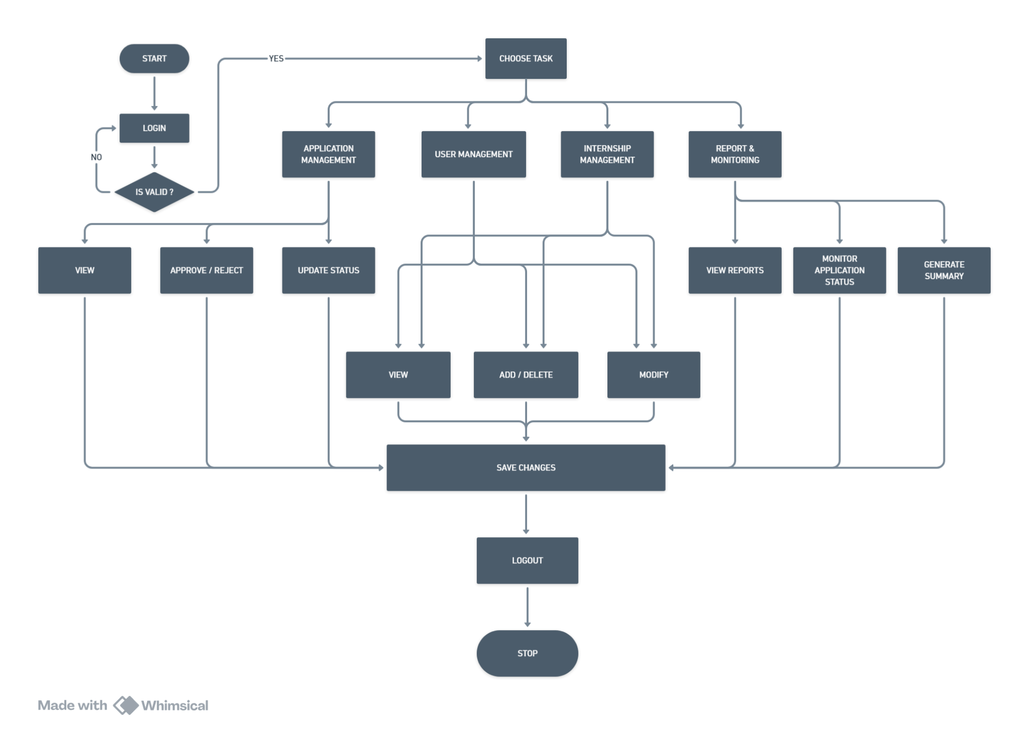
ADMIN MODULE

Slide 18
USER MODULE
User Sign up:
The user should sign up with their Full Name, Email id and Password.
2. User Login:
If the user has already signed in,then user need to login with their respective Email id and password.
If the credentials are valid, grant access to the user and allow them to use the system functionalities.
Select the appropriate vehicle that match the user's requirements.

Slide 19
USER MODULE (contd.)
3. Browse Internship
Allows users to explore available internship opportunities
Users can search internships based on keywords, company name, domain, or location
Displays internship details such as role, duration, and requirements
Makes it simple to find internships that match user interests
4. Manage Internship
Allows users to manage their internship-related activities
Helps users apply for internships through the system
Ensures all application details are submitted correctly
Makes the internship application process smooth and organized

Slide 20
USER MODULE (contd.)
5. Track Internship
Helps users monitor the status of their internship applications
Shows current status such as Applied, Under Review, Approved, or Rejected
Keeps users updated about application progress
Reduces the need for manual follow-ups
Provides transparency in the internship selection process

Slide 21
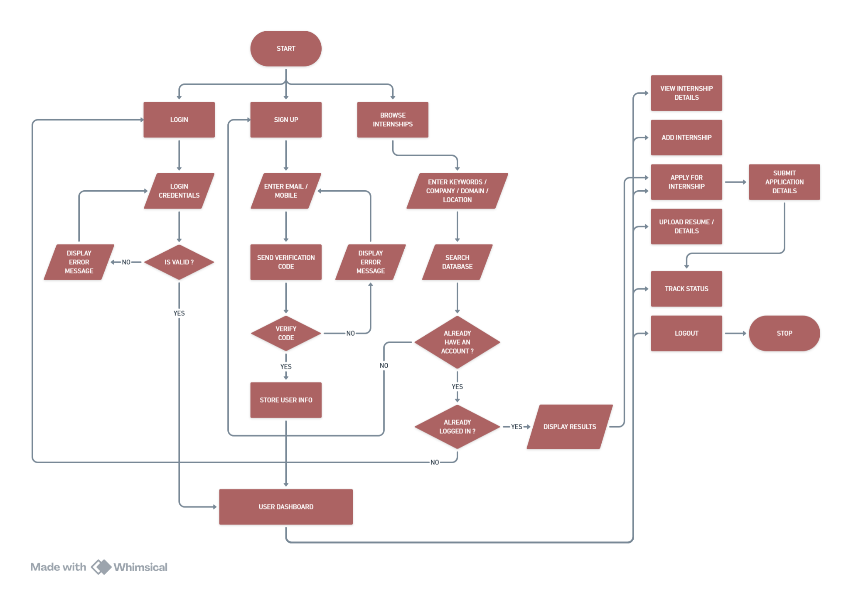
USER MODULE

Slide 22
INTERNSHIP MODULE
1. Internship Creation and Management:
This process starts with adding new internship details into the system
Internship information such as title, company name, domain, duration, location, and eligibility is entered
The system allows administrators to manage multiple internships efficiently
Helps ensure internships are properly listed and maintained
2. Internship Validation and Verification:
The system checks whether all internship details are correctly entered
Verifies required fields like company name, internship duration, and eligibility criteria
If incorrect or missing information is found, an error message is displayed
Only valid and complete internship data is allowed to proceed

Slide 23
INTERNSHIP MODULE (contd.)
3. Internship Data Storage:
Data includes internship information, availability status, and application details
Stored data can be accessed by both admin and user modules
Ensures data safety and easy retrieval
Supports long-term record keeping
4. Internship Availability:
Determines whether an internship is currently open or closed
Available internships are marked as Active
Unavailable or expired internships are marked as Inactive
Only active internships are visible to users
Helps users apply only for valid and open internships

Slide 24
INTERNSHIP MODULE (contd.)
5. Status Update and Synchronization:
Tracks the status of internship applications in real time
Status updates include Applied, Under Review, Approved, or Rejected
Changes are synchronized between admin and user modules
Keeps users informed about application progress
6. Internship Modification and Removal:
Allows administrators to modify internship details when needed
Internship information such as duration, eligibility, or availability can be updated
Outdated or invalid internships can be removed from the system
Changes are updated instantly in the database

Slide 25
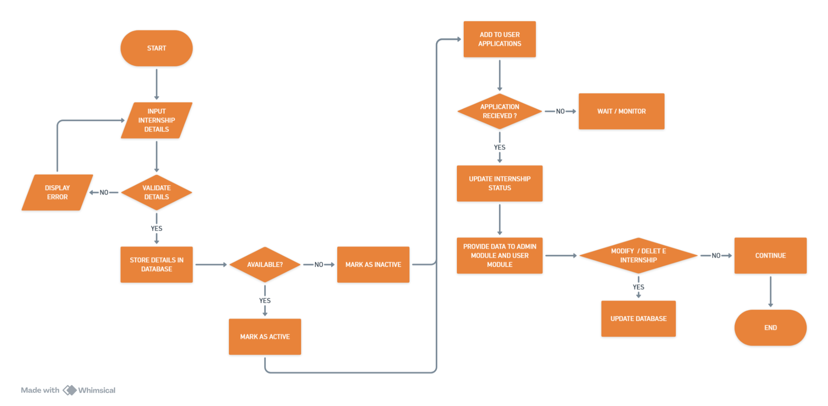
INTERNSHIP MODULE

Slide 26
FURTHER ENHANCEMENT
Our ongoing project includes:
Mobile Application Support:
Development of Android and iOS applications to allow users to manage internship applications on the go.
Automated Notifications:
Email and SMS alerts for application status updates, deadlines, interview schedules, and new internship postings.
Advanced Search and Filtering:
Filtering internships based on domain, location, duration, stipend, work mode, and required skills.
Analytics and Dashboard:
Visual dashboards showing application trends, success rates, and popular internship domains.
External Platform Integration:
Integration with internship and job portals such as LinkedIn and Internshala for importing internship listings.
Enhanced Security Features:
Role-based access control, multi-factor authentication, and encrypted data storage.

Slide 27
SCOPE
Target Users: Students, faculty coordinators, administrators, and recruiting organizations.
Core Features: Internship browsing, online application submission, application status tracking, and document management.
Advanced Features: Resume uploads, external internship link tracking, automated notifications, and analytics dashboards.
Administrative Features: User management, internship verification, application monitoring, and report generation.
System Accessibility: Web-based platform accessible on desktop, tablet, and mobile browsers.
Security and Data Protection: Secure login, data encryption, and controlled access to sensitive information.
Future Expansion: Can be extended to include placement management, training programs, and alumni tracking.

